Slide 1
Formative Assessment of Cognitively Complex Science Competencies Faranak Rohani, Aaron Rouby, & Adam LaMee
Center for Advancement of Learning and Assessment

Slide 2
Project Overview and Progress Summary

Slide 3
Major Research Project
Funded for three years by the Institute of Education Sciences (IES), U.S. Department of Education
Personnel involved
Six FSU faculty, six graduate students, CALA staff
Ten teachers and their students from five schools in the Florida Panhandle
Very significant others (External Review Team and State Review Team)

Slide 4
Need for an Alternative Strategy
Heavy reliance on large-scale assessments to test every student
Forces the use of multiple-choice format for efficiency with regard to administration, scoring, and cost
Narrows the range of competencies that are assessed and thus taught
Multiple Choice → Performance Assessment
Assesses competencies not measurable via
multiple-choice format

Slide 5
CALA’s Alternative Strategy
Typical Large-Scale Assessment Paradigm
CALA’s Large-Scale Assessment Paradigm
Individual Student Assessment by External Agency
Individual Student Assessment by Teachers + Samples of Students Assessed by External Agency (like NAEP)
Formative Assessment by Teachers

Slide 6
CALA’s Alternative Strategy
Evidence
Method
Examine the Next Generation Sunshine State Standards in 7th-grade science to identify competencies that cannot be assessed through multiple-choice format. Examine performance assessment literature and consult with assessment experts and science teachers to develop a framework for producing performance assessments of complex competencies.
Selection of Competencies and Development of Performance Assessment Specifications

Slide 7
CALA’s Alternative Strategy
Evidence
Method
With proper training, teachers will develop, administer, and score summative assessments that measure individual student’s knowledge
Teacher Summative Assessment
External agency will develop and administer external summative assessments to samples of students
External Summative Assessment
Scores from summative assessments by teachers and the external agent should correspond highly
Cross-Validation of Summative Assessments

Slide 8
CALA’s Alternative Strategy
Evidence
Method
Teachers will be able to integrate assessment with classroom instruction and learning based on specifications
Teacher Formative Assessment
Develop an effective strategy (cost, time, efficient scoring) that will allow the inclusion of performance assessments in large-scale testing
Sampling Strategy

Slide 9
Benchmarks and Competencies
SC.7.L.17.3: Describe and investigate various limiting factors in the local ecosystem and their impact on native populations, including food, shelter, water, space, disease, parasitism, predation, and nesting sites.
Competencies
Student can observe and describe a local ecosystem.
Student can determine potential limiting factors for specified populations in a local ecosystem.
Student can explain complex relationships between biotic and abiotic factors in an ecosystem.
Examine the Next Generation Sunshine State Standards in 7th-grade science to identify competencies that cannot be assessed through multiple-choice format. Examine performance assessment literature and consult with assessment experts and science teachers to develop a framework for producing performance assessments of complex competencies.
Selection of Competencies and Development of Performance Assessment Specifications
Notes:
In the first stage, a panel of assessment and content experts reviewed the state of Florida’s curriculum standards, known as the Next Generation Sunshine State Standards, for 7th-grade science.
During this review, the panel sought to identify competencies either implied or explicitly stated in the standards that are not currently assessable in the multiple-choice and short answer formats that characterizes large-scale testing.
These competencies are descriptions of particular mental abilities or skills that students must acquire in order to meet the curriculum standards set within a particular domain at a particular grade level.
To determine whether a given competency was likely unassessable in the multiple-choice or short answer format, the panel relied on group discussion and debate until consensus was reached.
Because individual curriculum standards, known as benchmarks, often represent an array of interrelated mental abilities, the panel often distilled several related but distinct competencies from a single benchmark.

Slide 10
Competencies
Student can formulate a scientifically testable question(s) that relates to the context or data provided.
Student can create a plan for carrying out a scientific investigation, including what, when, and how to measure variables.
Student can organize data by creating a table, chart, or other representation to facilitate interpretation.
Student can make inferences and predictions and use the data to defend or refute conclusions.
Student can observe and describe a local ecosystem.
Student can determine potential limiting factors for specified populations in a local ecosystem.

Slide 11
Competencies
Student can carry out a plan for scientific investigations of various types.
Student can explain complex relationships between biotic and abiotic factors in an ecosystem.
Student can create a diagram (i.e., food web) that illustrates the flow of energy among producers, consumers, and decomposers within an ecosystem.
Student can investigate multiple factors that impact native populations in the ecosystem.
Student can explain the difference between theories and laws.
Student can provide examples of evidence that support a scientific theory.

Slide 12
Assessment Focus: Type of Knowledge
 |  | Declarative | Procedural | Problem Solving
Year 1 | Assessment 1: Formulating a Scientifically Testable Question |  | P
 | Assessment 2: Creating a Plan for a Scientific Investigation |  |  | P
 | Assessment 3: Organizing and Making Inferences/Predictions from Data |  | P
 | Assessment 4: Observing/Determining Limiting Factors of an Ecosystem |  | P

Slide 13
Assessment Focus: Type of Knowledge
 |  | Declarative | Procedural | Problem Solving
Year 2 | Assessment 5: Conducting Scientific Measurements |  | P
 | Assessment 6: Explaining Complex Biological Relationships | P
 | Assessment 7: Drawing a Food Web |  | P
 | Assessment 8: Investigating Limiting Factors |  | P
Year 3 | Assessment 9: Differentiating between Theory and Law | P
 | Assessment 10: Providing Supporting Evidence for a Theory | P

Slide 14
Now What?

Slide 15
Doing science means…
Having science content knowledge
Working problems
Solving equations
Classifying, labeling, stamp collecting, etc.

Slide 16
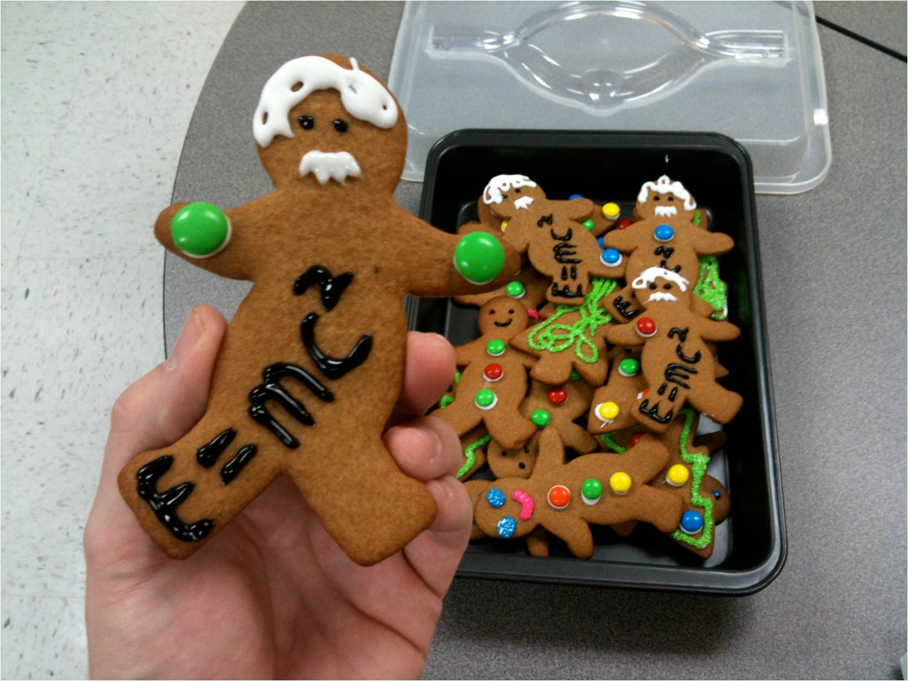
But it’s more than just math…

Slide 17
Doing science also means…
Knowing how to do science

Slide 18
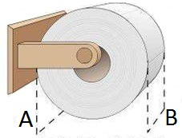
How to identify a problem…

Slide 19
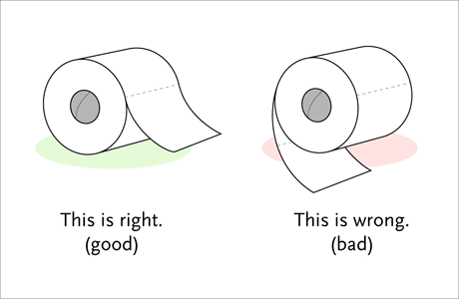
How to formulate a hypothesis...

Slide 20
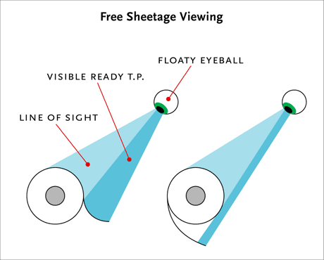
How to design an investigation…

Slide 21
Science education means…
Students and teachers have a clear idea of learning goals.
Students are active participants in the learning process.
Students receive feedback frequently, from different sources, and in different ways.
Students demonstrate evidence of their understanding in a variety of ways.
Knowing What Students Know, NRC 2001

Slide 22
What Is Next?
Teach it before you test it!

Slide 23
Formative Assessment
Each Teacher
Developed two formative assessments
Revised formative assessments based on the review and feedback by the research team
Administered the formative assessments

Slide 24
Performance Assessment Specifications

Slide 25
Specifications
Documents that serve as a “recipe” for creating assessments that adhere to particular criteria
Provide a framework for producing a family of parallel assessments
Develop performance assessments capable of measuring complex science competencies and expanding the range of competencies evaluated
Selection of Competencies and Development of Performance Assessment Specifications
Notes:
A specification serves as a sort of recipe for creating performance assessments that adhere to certain criteria. Its purpose is to provide a framework for producing a family of parallel performance assessments . This means that each assessment in the family could be used interchangeably with any other assessment in the family because they assess the same knowledge and result in comparable scores.

Slide 26
Specifications
Components
Competency statement
Evidence
Example task
Scoring plan for the example task
Procedure for creating parallel tasks
Scoring plan for parallel tasks

Slide 27
Specification Example

Slide 28
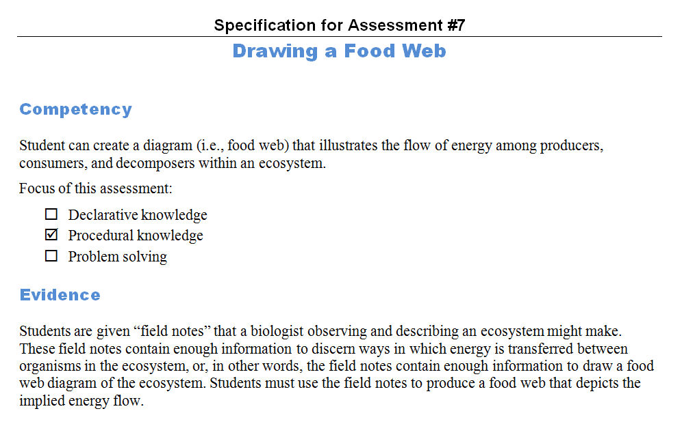
Specification 7: Target Competency
Notes:
Introduce Specification 7: Draw a Food Web
Brief walkthrough of Spec 7’s
Target competency
Sample task
Scoring plan for sample task

Slide 29
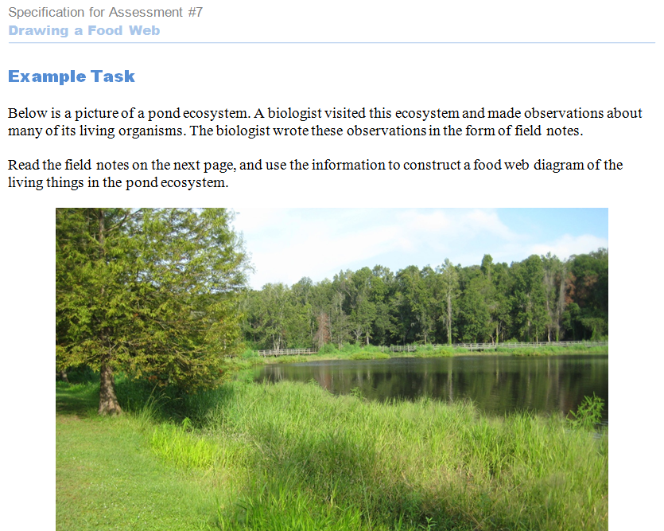
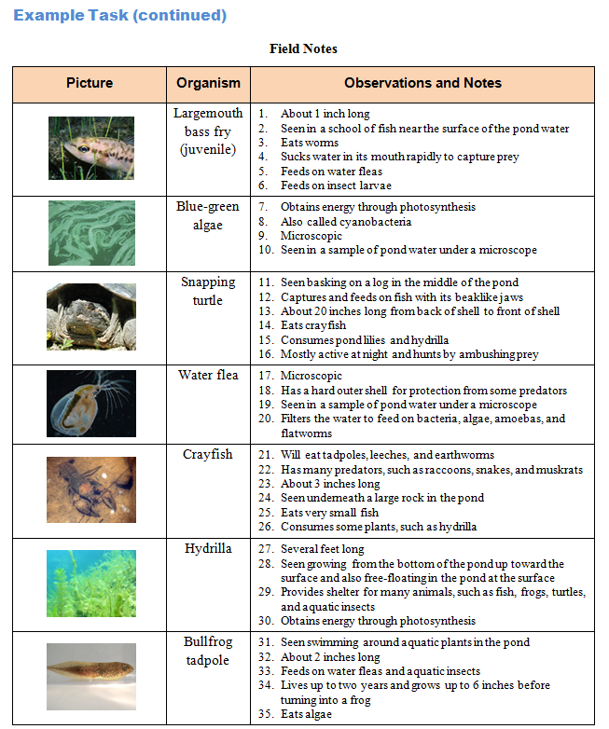
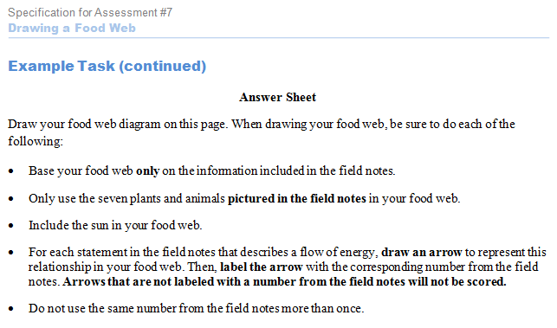
Specification 7: Sample Assessment
Notes:
Introduce Specification 7: Draw a Food Web
Brief walkthrough of Spec 7’s
Target competency
Sample task
Scoring plan for sample task

Slide 30
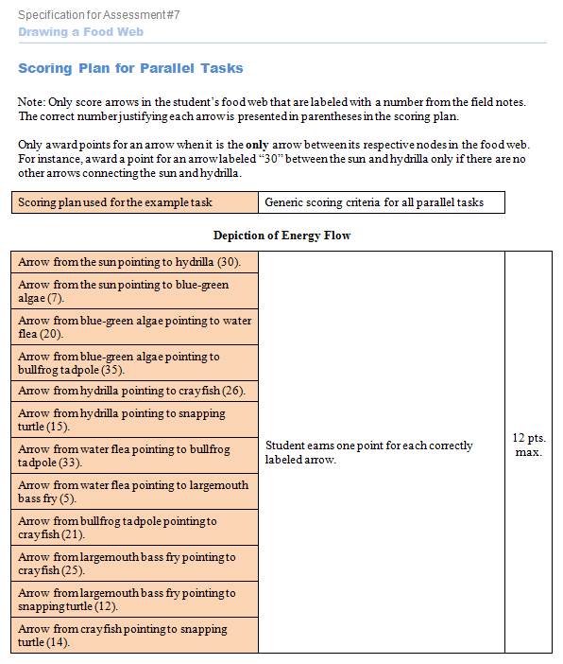
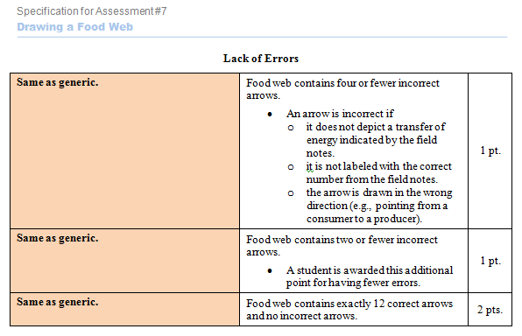
Specification 7: Scoring Plan
Notes:
Introduce Specification 7: Draw a Food Web
Brief walkthrough of Spec 7’s
Target competency
Sample task
Scoring plan for sample task

Slide 31
Formative Assessment

Slide 32
Formative Assessment
Formative assessment is a powerful strategy for determining:
What students already know
Students’ misconceptions
What course of instruction will help students achieve a particular competency
Teachers use this information to modify teaching and learning activities and provide feedback to students.
Formative assessments are essential, particularly when a target competency is complex. Research shows that, when carefully used, formative assessments substantially increase student learning.
Teachers will be able to integrate assessment with classroom instruction and learning based on specifications
Teacher Formative Assessment

Slide 33
Formative Assessment
To assist teachers in the process of formative assessment, we have developed two documents:
Formative Assessment Worksheet
Supports teachers in developing a learning progression that helps students achieve a target competency. Using this worksheet, teachers develop a sequence of learning goals and plan instruction and assessment related to each goal.
Qualities Sought in Formative Assessment Worksheets
Provides guidelines for completing various sections of the formative assessment worksheets: (1) student misconceptions, (2) the learning progression, and (3) descriptions of instructional and assessment activities related to each learning goal within the progression.

Slide 34
Misconceptions

Slide 35
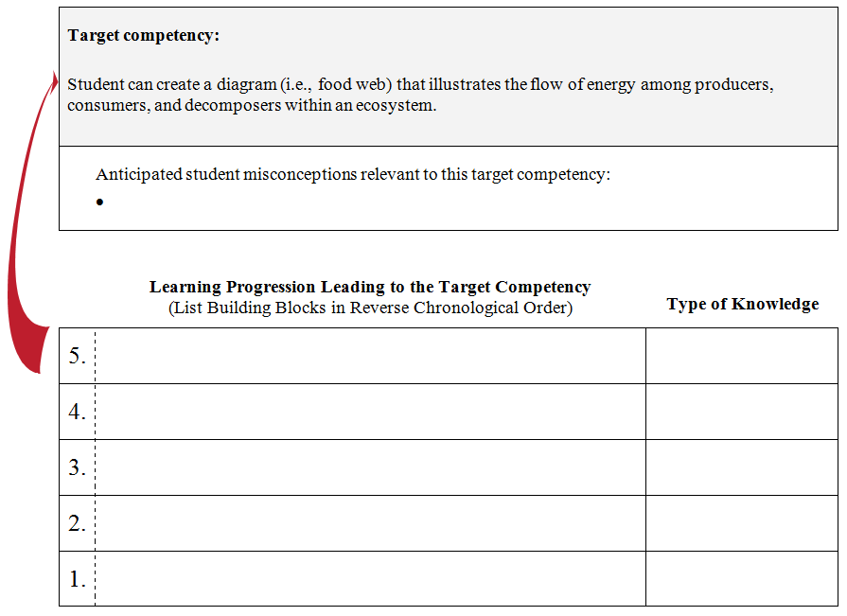
Misconceptions
List any misconceptions students are likely to have.
Include only misconceptions that are likely to be shared by many students.
Your learning progression should address any misconceptions you have identified.
Notes:
Misconceptions can inhibit students' achievement of learning goals and the target competency. Awareness of common student misconceptions helps teachers address the misconceptions when developing learning progressions, instruction, and assessments. These misconceptions may have been observed in the previous student population or in the current one.

Slide 36
Building Blocks

Slide 37
Building Blocks
A learning progression consists of a careful sequence of building blocks that students must achieve en route to a more complex target competency.
Building blocks are subskills and enabling knowledge that will lead to achievement of the target competency.

Slide 38
Building Blocks = Measurable Goals
It is important to express each building block as a measurable goal.
To be a “goal,” a building block must identify the target of learning: what it is that students will be able to do.
To be “measurable,” a building block must be expressed as something that is directly observable.
Expressing each building block as a measurable goal makes it much easier to plan effective instruction and assessment because the intended instructional outcome is clear.

Slide 39
Building Blocks = Measurable Goals
Here is an example of a measurable goal:
Students can identify questions that are scientifically testable.
This goal clearly suggests what a student who has achieved the goal will be observed doing.

Slide 40
Building Blocks = Measurable Goals
Words like “understands” and “knows” are not acceptable words within a measurable goal.
When these words are used, it is not clear what knowledgeable versus less knowledgeable students do.
Instead, the measurable goal should state what you would observe that indicates students understand or know something.
Vague, Immeasurable Goals
Students understand the process of photosynthesis.
Students know the difference between scientific laws and theories.
Measurable Goals
Students can explain and illustrate the process of photosynthesis with respect to energy flow in ecosystems.
Students can compare and contrast characteristics of laws and theories and provide examples of each.

Slide 41
Building Blocks = Measurable Goals
Measurable goals clearly establish the student outcomes you are trying to achieve, but they should not describe instructional or assessment strategies explicitly.
A common mistake is to state building blocks as descriptions of classroom activities or learning strategies rather than outcomes of learning.
Here is an example of this mistake:
Students will be provided examples of research questions to evaluate.

Slide 42
The Learning Progression
Notes:
A sequence of learning goals that supports student acquisition of a complex target competency
We begin by:
indentifying anticipated student misconceptions,
writing learning goals,
organizing the goals into a learning progression

Slide 43
Learning Progression = ∑ Building Blocks
Target Competency: Students can create an appropriate chart to represent a set of data.
5. Students can determine the appropriate scale for a given set of data.
4. Students can explain which features of a data set correspond with particular features of charts (e.g., the column heading on a table will become an axis label on a chart).
3. Students can identify parts (e.g., axes, headings, scale, points, sections, bars) of various charts.
2. Students can determine which type of chart will best display a given data set.
1. Students can compare and contrast types of charts (e.g., pie, line, bar, scatterplot).
Notes:
This will give a general idea of what we’re talking about and where we’re going.

Slide 44
Learning Progression = ∑ Building Blocks
Identify the major building blocks of the learning progression.
These building blocks are listed in reverse order, indicating that each block builds on the one below it.

Slide 45
Desired Characteristics of Learning Progressions
The learning progression should prepare your students for the target competency.
The learning progression should be limited to goals that are needed to achieve the target competency.
The goals should be clearly sequential, with the later measurable goals clearly building on the earlier measurable goals.

Slide 46
Desired Characteristics of Learning Progressions
The first measurable goal within the progression should be a goal somewhat above what your students already can do.
The last measurable goal within the progression should be approaching the target competency.
There should not be large leaps or gaps in required knowledge and skill between adjacent goals.
Each goal should build upon the previous one so that there is a smooth transition from each goal to the next along the way to the target competency.

Slide 47
Learning Progression = ∑ Building Blocks
For each building block, indicate whether declarative knowledge or procedural knowledge will be the focus.
Declarative knowledge: Students are assessed by asking them to explain something or otherwise state what they know.
Procedural knowledge: Students are assessed by having them employ a procedure, such as by demonstrating a technique.
Notes:
For each building block, indicate whether declarative knowledge or procedural knowledge will be the focus. This will influence how the measurable goal is worded and definitely affect how it is assessed.
When the focus is on declarative knowledge, students are assessed by asking them to explain something or otherwise state what they know.
When the focus is on procedural knowledge, students are assessed by having them employ the procedure, such as through demonstration of a technique or classification of previously unused instances as examples versus nonexamples of a concept.
This identification of the type of knowledge represented by each competency is critical because different types of assessments must be used to measure proficiency with different types of capabilities.

Slide 48
Type of Knowledge
Student can create a diagram (i.e., food web) that illustrates the flow of energy among producers, consumers, and decomposers within an ecosystem.
What type of capability does this competency represent?
If the capability is declarative, what would be the focus of the assessment?
Knowledge of energy transfer and feeding relationships among a set of specific organisms
If the capability is procedural, what would be the focus of the assessment?
Ability to construct a food web diagram per se, without prior knowledge of specific organisms accounting for variability in scores
Notes:
Here is an example of a competency in which the type of capability is less obvious and perhaps open to more than one interpretation.

Slide 49
Learning Progression Example
Target Competency: Students can create an appropriate chart to represent a set of data. | Type of Knowledge
1. Students can compare and contrast types of charts (e.g., pie, line, bar, scatterplot). | Declarative

Slide 50
Learning Progression Example
Target Competency: Students can create an appropriate chart to represent a set of data. | Type of Knowledge
2. Students can determine which type of chart will best display a given data set. | Procedural
1. Students can compare and contrast types of charts (e.g., pie, line, bar, scatterplot). | Declarative

Slide 51
Learning Progression Example
Target Competency: Students can create an appropriate chart to represent a set of data. | Type of Knowledge
3. Students can identify parts (e.g., axes, headings, scale, points, sections, bars) of various charts. | Procedural
2. Students can determine which type of chart will best display a given data set. | Procedural
1. Students can compare and contrast types of charts (e.g., pie, line, bar, scatterplot). | Declarative

Slide 52
Learning Progression Example
Target Competency: Students can create an appropriate chart to represent a set of data. | Type of Knowledge
4. Students can explain which features of a data set correspond with particular features of charts (e.g., the column heading on a table will become an axis label on a chart). | Declarative
3. Students can identify parts (e.g., axes, headings, scale, points, sections, bars) of various charts. | Procedural
2. Students can determine which type of chart will best display a given data set. | Procedural
1. Students can compare and contrast types of charts (e.g., pie, line, bar, scatterplot). | Declarative

Slide 53
Learning Progression Example
Target Competency: Students can create an appropriate chart to represent a set of data. | Type of Knowledge
5. Students can determine the appropriate scale for a given set of data. | Procedural
4. Students can explain which features of a data set correspond with particular features of charts (e.g., the column heading on a table will become an axis label on a chart). | Declarative
3. Students can identify parts (e.g., axes, headings, scale, points, sections, bars) of various charts. | Procedural
2. Students can determine which type of chart will best display a given data set. | Procedural
1. Students can compare and contrast types of charts (e.g., pie, line, bar, scatterplot). | Declarative

Slide 54
Learning Progression Non-Example
Target Competency: Students can create an appropriate chart to represent a set of data.
1. Students understand that science involves collecting data.
Goal #1 is not measurable as written.
Goal #1 only slightly relates to the target competency.
Notes:
Elicit audience responses before revealing the error with each building block

Slide 55
Learning Progression Non-Example
Target Competency: Students can create an appropriate chart to represent a set of data.
2. Students can interpret bar graphs and scatterplots and write a conclusion.
1. Students understand that science involves collecting data.
There is a large leap of required knowledge and skills between Goals #1 and #2.

Slide 56
Learning Progression Non-Example
Target Competency: Students can create an appropriate chart to represent a set of data.
3. Students collect data and create a table, then share with the class.
2. Students can interpret bar graphs and scatterplots and write a conclusion.
1. Students understand that science involves collecting data.
Goal #3 is not in alignment with the target competency. Being able to collect data does not relate directly to being able to chart the data.

Slide 57
Learning Progression Non-Example
Target Competency: Students can create an appropriate chart to represent a set of data.
4. Students can label the parts of a graph.
3. Students collect data and create a table, then share with the class.
2. Students can interpret bar graphs and scatterplots and write a conclusion.
1. Students understand that science involves collecting data.
Goal #4 is actually well-written; it is measurable and related to the target competency.

Slide 58
Learning Progression Non-Example
Target Competency: Students can create an appropriate chart to represent a set of data.
5. Students will compare different kinds of graphs.
4. Students can label the parts of a graph.
3. Students collect data and create a table, then share with the class.
2. Students can interpret bar graphs and scatterplots and write a conclusion.
1. Students understand that science involves collecting data.
There is a large leap of knowledge and skill between Goal #5 and the target competency.

Slide 59
Practice Time
Your packet contains…
Performance
Assessment
Specification #7
Notes:
Adam:
Walk attendees through (1) target competency and evidence, (2) sample task, and (3) sample scoring plan.

Slide 60
Practice Time
What are some relevant misconceptions students might have?
Notes:
Adam:
Elicit responses from attendees.

Slide 61
Practice Time
Your packet contains…
Formative
Assessment
Worksheet
Notes:
Adam:
Have attendees turn to page 1 of worksheet.

Slide 62
Practice Time
Try writing a learning progression for this target competency.
We’ll give you a few minutes…
Notes:
Adam:
Have attendees work in groups to fill out page 1 of worksheet. After 5-15 minutes, discuss and elicit examples.
*Note – finish with 15 minutes left to show teacher example and field questions.

Slide 63
Practice Time
Your packet contains…
One of our teacher’s
learning progressions
Notes:
Adam:
Briefly show teacher example of filled-out worksheet.

Slide 64
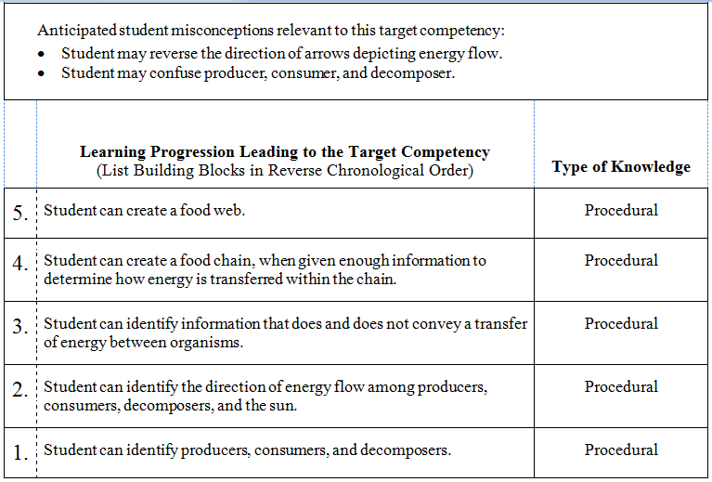
Example Learning Progression

Slide 65
Thanks for Attending
Center for Advancement of
Learning and Assessment
Notes:
Fara, Aaron, Adam:
Questions and comments from audience.

